Slide 1


Strategic Investment Proposal: Driving Growth and Profitability!
Achieving Profitability and Sustainable Growth Through Strategic Investment.
by Jitu Prosad Saha

Slide 2
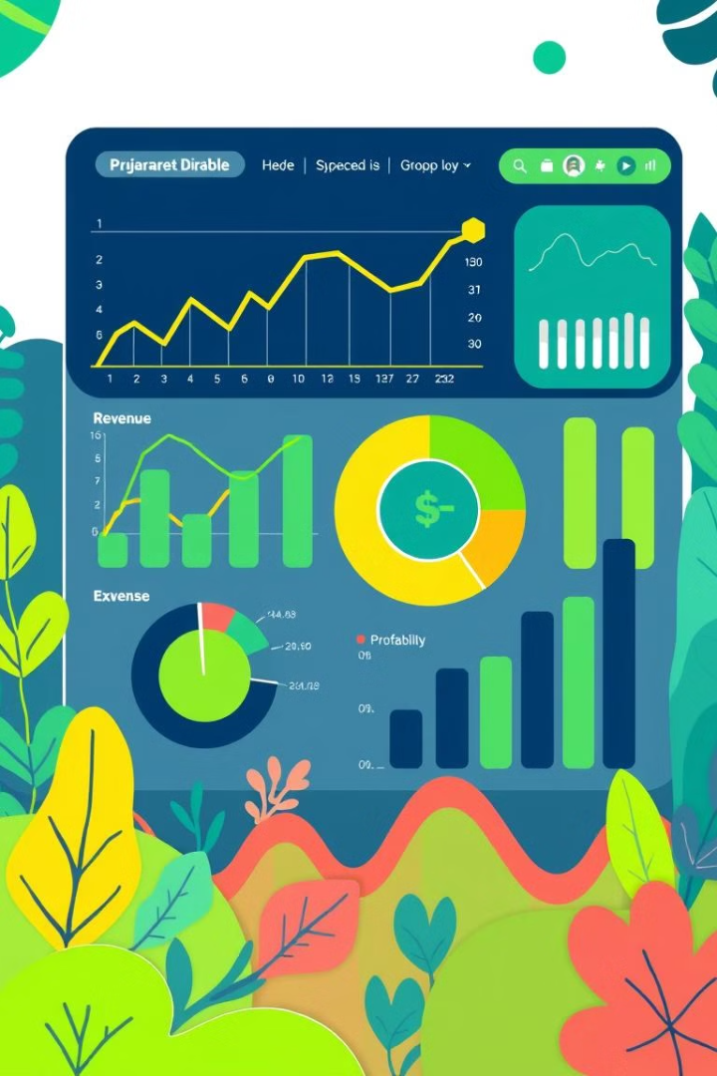
Financial Overview
$251.5M
Total Revenue
$248.9M
Total Expenses
$2.7M
Net Profit
📌 Revenue Breakdown:
- LD Content Generation: $76,948,000.0M
- HR L&D Product: $45,470,000.0M
- AI Solutions Services: $120,880,000.0M (Largest Revenue Stream)

Slide 3

Executive Summary: Poised for Growth
1
Growth Focus
2
Profitability
Seeking investment to fuel expansion, product development, and marketing.
Projected profitability within months., driven by strategic revenue diversification and cost optimization.
3
Revenue Growth
Significant market opportunity in AI automation.

Slide 4
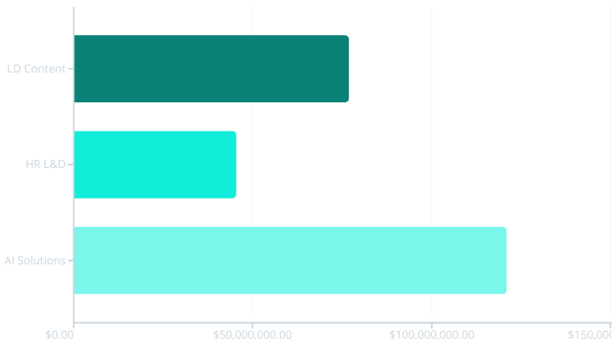
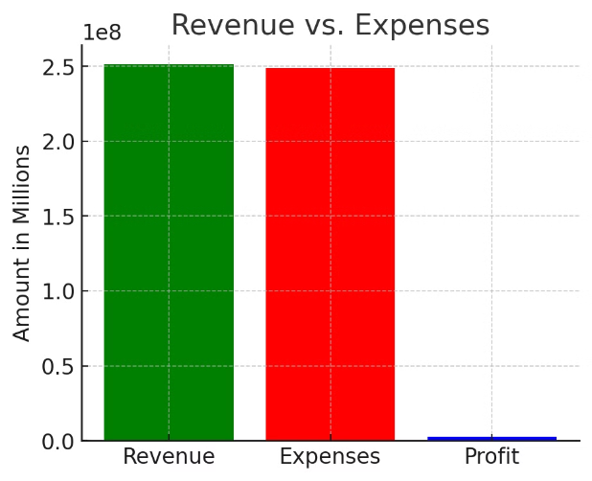
Financial Overview:
Laying the Foundation for Growth

Slide 5




Strategic Investment Priorities
Marketing Expansion
Tech & Product
Sales & Service
Increase digital advertising and partnerships.
Strengthen infrastructure and development.
Invest in sales partners and client relations.

Slide 6
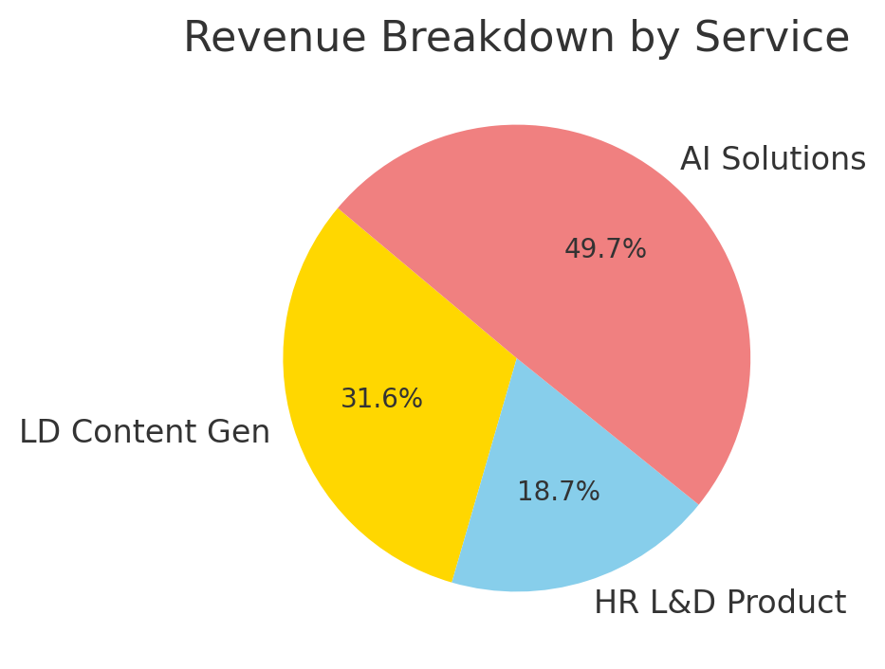



Revenue Growth Driven by :
Diversified Revenue Streams
LD Content Generation
Engaging learning experiences.
HR L&D Product
Solutions for HR teams.
AI Solutions Services
Custom AI implementations.

Slide 7
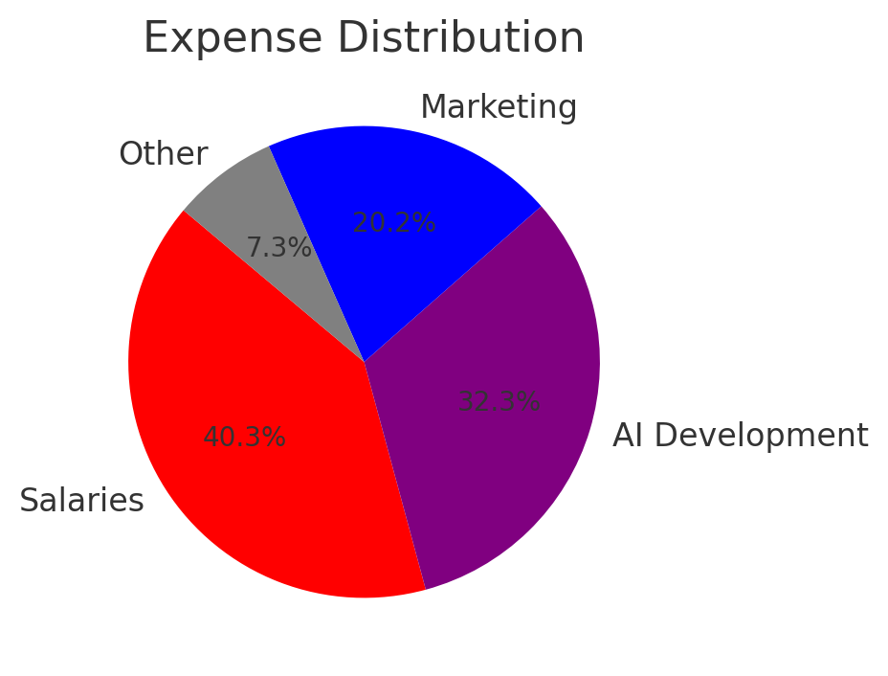
Path to Profitability and
Strong financial returns
Revenue Growth
Diversified revenue streams.
Cost Optimization
Streamlined operations.
Strong Returns
Increased profitability.

Slide 8



Investment Ask: Fueling Growth
Product Development
2
Enhance AI solutions.
Marketing & Sales
1
Expand market reach.
3
Operations & Expansion
Scale the infrastructure.
Seeking funding to scale AI solutions and expand market reach.

Slide 9
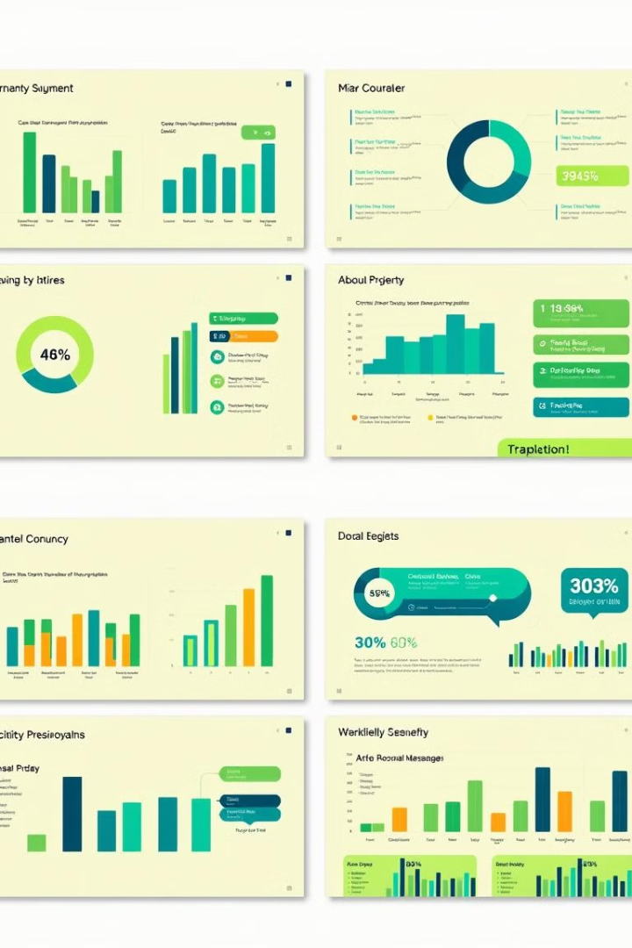
Appendix: Supporting Data
Financial Projections
Market Research
Insights into AI trends.
Detailed forecasts and analysis.
Team Biographies
Background of key members.

Slide 10
Experienced Leadership and Dedicated Team
Shohini
L&D Product manager, Managing content team, marketing/sales for content service and L&D product – 7+ years experience.
Sanjoy
Tech guidance for L&D product and Coding based AI solutions, Trainings, marketing/sales for content service and L&D product and AI Solutions service. 8+ years experience.
Rohit
Tech guidance for low code / no code solutions, developing solutions, Program mgmt for 3 revenue streams, process and SOPs definition, marketing / sales for AI solutions– 6+ years experience.
Ajay
Marketing/sales for content service and L&D product and AI Solutions service, training –
6+ years experience.

Slide 11
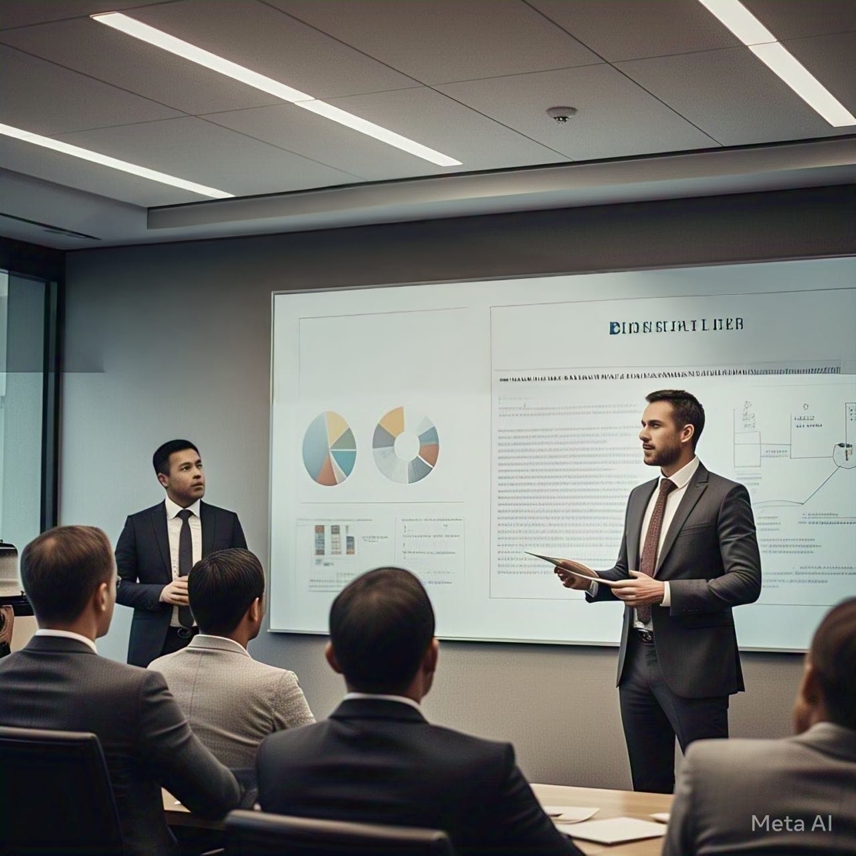
Investment Justification
✅ Strong Revenue Model:** Diversified revenue
streams ensure stability.
✅ Scalability:** AI-driven solutions can expand market
reach.
✅ Market Demand: Increasing adoption of AI-
powered learning solutions.
✅ High-Profit Potential:** Despite expenses,
profitability is sustainable.
Recommendation: Investment in AI and marketing
will drive exponential growth.

Slide 12
